Slide 1
An overview of vaping
Lawrence m. simon, md, FACS
Regional medical director
Blue cross and blue shield of Louisiana

Slide 2
overview
What is vaping?
Dangers of vaping
Is vaping addictive?
Is vaping harmful to others
Vaping vs cigarette smoking
COVID-19 Overview

Slide 3
What is Vaping
The use of a device that produces an aerosol from a solution for inhalation through a mouthpiece by the user
Not truly a vapor!
Typical solutions:
  Nicotine
  Flavoring chemicals
  Other additives

Slide 4
Myth #1: Vaping cannot hurt bystanders
Vaping is not truly a vapor
It is an aerosol
  A suspension of fine particles in gas
  Bystanders can be exposed involuntarily to the emissions in a exhaled aerosol

Slide 5

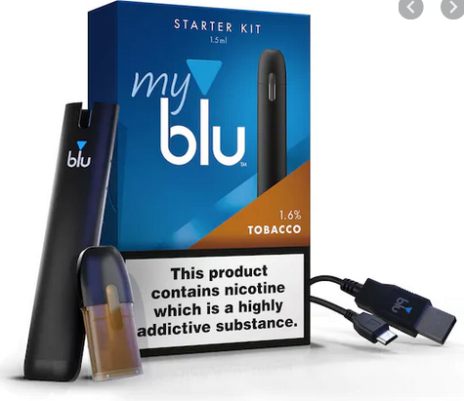
Various devices
(Conventional) e-cigarettes
Pens and flashlights
Flash drive
“Mods”- modifiable
  Large cartridges
Pods, vaporizers, hookahs

Slide 6
Epidemiology of youth vaping
On the rise significantly from 2009-2019
Most common tobacco product used among those <18y/o
Validated across multiple large cross-sectional surveys
  2018 National Youth Tobacco Survey: 20.8% of High School and 4.9% of Middle School Students
  2017: Monitoring the Future: 17% of 12th graders, 13% of 10th graders, 7% of 8th graders
  Youth Risk Behavior Surveillance System: 13.2% of high school students
Pediatrics, 2019

Slide 7
Epidemiology of youth vaping
On the rise significantly from 2009-2019
Most common tobacco product used among those <18y/o
Validated across multiple large cross-sectional surveys
  3 million high school students and 570,000 middle school students
  Boys > girls
  Non-white Hispanic and Hispanic
  Interestingly, use decreases with age. Majority of adult users are prior cigarette smokers
Pediatrics, 2019

Slide 8
Marketing and availability
Widely available
Many e-cigarette companies are owned by tobacco companies
Marketed directly to youth
  Flavors and Features
  Youth targeted media
  Are able to use tactics that are illegal for conventional tobacco products
Regulations vary by state.

Slide 9
Louisiana vaping laws
Must be at least 18-years-old to purchase or sell-to (21 Federal)
License/permit is required for all retailers
Prohibited on school property
Not prohibited indoors by stated law
Prohibited indoors in multiple parishes/cities

Slide 10
Federal regulation
December 2019: Amended the Federal Food, Drug, and Cosmetic Act
  Raised Federal minimum age for sale of tobacco from 18 to 21 years
  Includes e-cigarettes
February 2020: Prohibits flavors other than menthol and tobacco in closed systems (pods/cartridges).
Excludes open tanks systems.

Slide 11
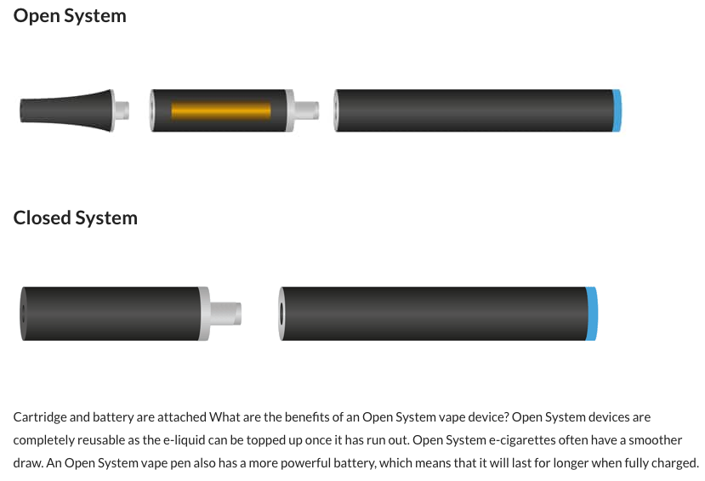
Open vs closed system
https://www.blu.com/en/GB/explore/about-blu-vape-pens-e-cigarettes-and-flavours/what-are-open-and-closed-e-cigarette-systems

Slide 12
Components of e-cigarette solutions
No federal quality standards
Nicotine is the most common solution
  Strong addictive potential
Some cartridges are refillable (“open”)
  Marijuana
  Other substances
Additives

Slide 13
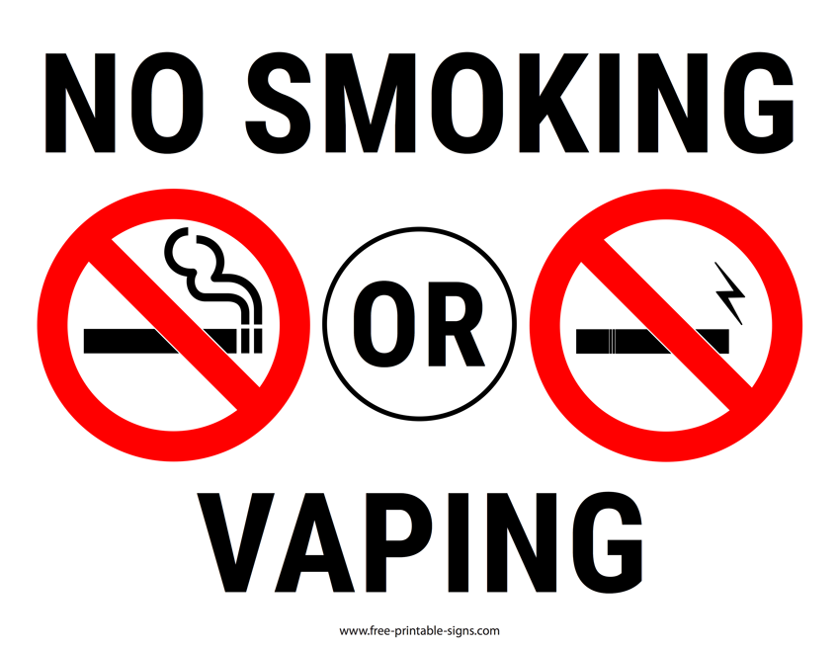
Additives
No federal standards or consistent labeling
Many standard solutions have been found to be cytotoxic to human embryonic stem cells

Slide 14
Additives
Numerous carcinogens and other toxins have been found when studied
  Aldehydes
  Nitrosamines
  Carrier Solvents
  Tobacco alkaloids
  Polycyclic aromatic hydrocarbons
Numerous carcinogens and other toxins have been found when studied

Slide 15
Nicotine toxicity
Wide discrepancies between labeled amount and actual amount found in studies
Nicotine can exceed amount in traditional cigarettes
Nicotine is both toxic and highly addictive
Particular concern in adolescents with developing brains
National Academy of Sciences, 2018

Slide 16
Nicotine toxicity
Adolescents more likely to experiment
Adolescents more susceptible to chemical addiction (developing brain)
  Earlier addiction→ Stronger addiction
Toxicity exaggerated due to developing status of brain
Multiple reports of acute nicotine toxicity in teens
  Role of unknown nicotine concentration?
National Academy of Sciences, 2018

Slide 17
Poisonings and injuries
Increased substantially since 2011
Mild cases often resolve within 12-24 hours with no treatment
Severe cases can result in hospitalization and death
Additional risk of button battery ingestion
Child Nicotine Poisoning Prevention Act
  Thousands of cases of poisoning annually
Pediatrics, 2019

Slide 18
Symptoms of nicotine poisoning
Acute
  Excessive saliva
  Nausea/vomiting
  Stomach pain
  Headache
  Anxiety/tremors
  Elevated HR
  Tachypnea
After 1 hour
  Low BP
  Bradycardia
  Shallow breathing
  Diarrhea
  Fatigue
  Weakness
  Pale skin
Extreme cases
  Seizures
  Coma
  Breathing difficulties
  Respiratory failure
  Death
On the rise

Slide 19
Public health effects of vaping
Discharged and exhaled aerosol can pose a risk to bystanders
Similar to second hand smoke
Deposited onto surfaces (third hand smoke)
Known toxins/carcinogens (including nicotine)
Limited human studies available.
Adolescent users at increased risk of cough/wheeze/asthma exacerbations

Slide 20
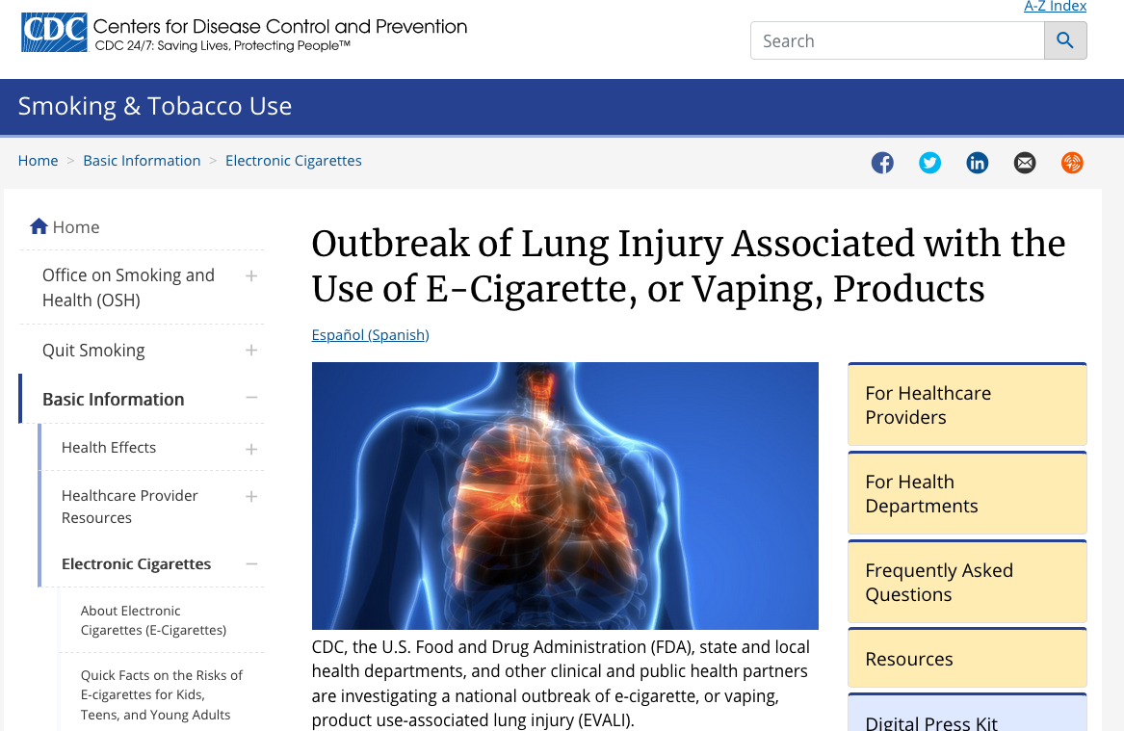
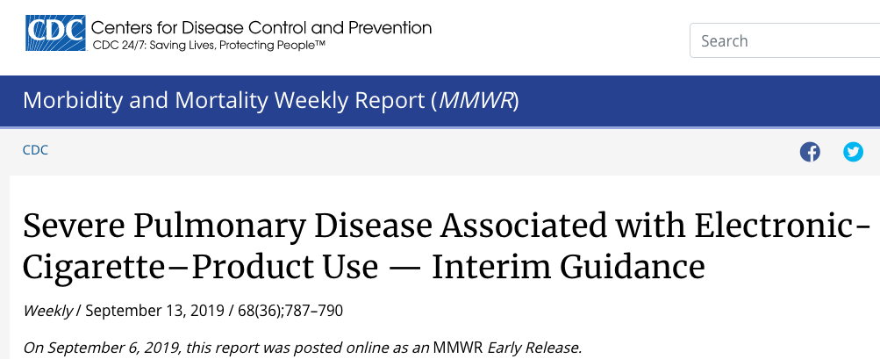
Other injuries from vaping
Chronic lung disease/asthma
COPD
Cardiovascular disease
Cancer
www.cdc.gov/mmwr

Slide 21
Progression to regular cigarettes
Extensively studied
Adolescents young adults (14-30 years of age):
  Those who use e-cigs are 3.6 times more likely to use traditional cigarettes
  Even those who have lower social/behavioral risk factors for cigarette use
Concern for reversing the declining trend of cigarette use
Pediatrics, 2019
JAMA Pediatr, 2017

Slide 22
Can e-cigs help smokers quit
Not supported by scientific evidence
National Academies of Sciences, Engineering, and Medicine
  No evidence that e-cigs are superior to no treatment
Studies show that cigarette smokers using e-cigs have lower rates of success
However, changing to e-cigs may pose a lesser risk than continued use of combustible tobacco to the smoker
Not necessarily better for the general public
Pediatrics, 2019
NASEM, 2018

Slide 23

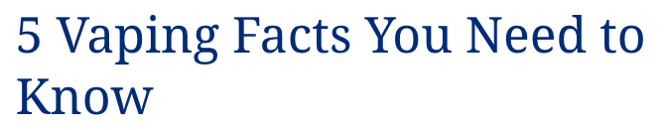
Aping is Less Harmful Than Smoking, but It’s Still Not Safe
Research Suggests Vaping is Bad for Your Heart and Lungs
Electronic Cigarettes Are Just As Addictive As Traditional Ones
Electronic Cigarettes Aren’t The Best Smoking Cessation Tool
A New Generation Is Getting Hooked on Nicotine
https://www.hopkinsmedicine.org/health/wellness-and-prevention/5-truths-you-need-to-know-about-vaping

Slide 24
Thoughts of Organized medicine
American Medical Association:
  Total ban on all non-FDA approved vaping products (prescription only)
  Research funding to study safety/efficacy of vaping products
  Increased research into nicotine/tobacco cessation
  Advocate for expansion of diagnostic codes
American Academy of Pediatrics
  Essentially, apply all existing combustible tobacco regulations to e-cigarettes and vaping products

Slide 25
Random thoughts
Do not make patients feel guilty
Empathize with patients
  We all have faults
  Brain chemistry
Emphasize the addictive nature and how challenging it is
Try to understand the patient’s self-identity
Ultimately, the patient has to want to quit

Slide 26
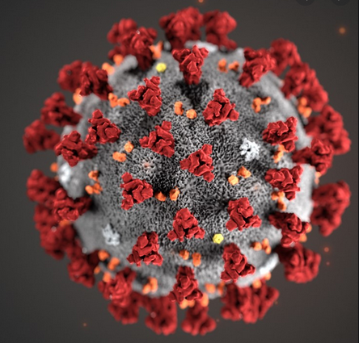
Covid-19 update

Slide 27
Current state of affairs
SARS-CoV2
RNA based Coronavirus
More contagious and more fatal than the flu
  Each person with COVID-19 infects ~2 other people
  Louisiana mortality rate over 4% (influenza average 0.1%)
Planning for surge is ongoing across the state
Curve is still on the “upslope”

Slide 28
What we don’t know
When it will end
How many people have been infected
  Virus vs antibody testing
Airborne vs. droplet spread
  Evidence suggests that it can possibly live suspended in air
Seasonal status
  Strong reason to suspect it will not be
Immunity after infection→ role of antibody testing?

Slide 29
recommendations
Social distancing
  Currently at least through April 30, 2020
Wash hands
  20 second
Clean all surfaces
  Unclear how long it lives on surfaces
Wear cloth mask outdoors and leave house as little as possible

Slide 30
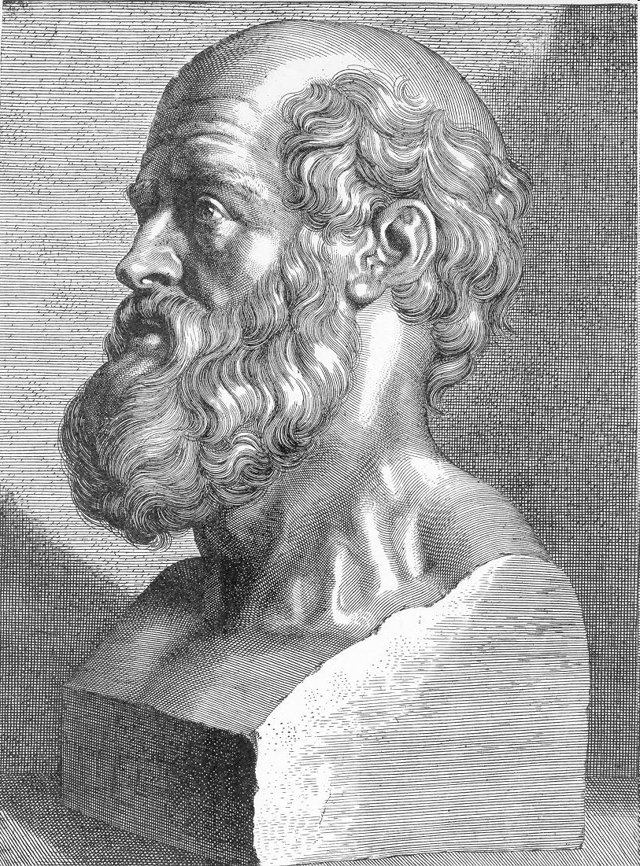

Thank you

