Slide 1
Anxiety: When is it a healthy, normal response and when is it a mental illness
Kathleen Crapanzano, MD, MAcM
Lauren Crapanzano Jumonville, MBA

Slide 2
Disclosures
Neither of us have any financial conflicts of interest to report
I borrowed a lot of my slides from Dr. Thida Thant, Assistant professor of Psychiatry at University of Colorado

Slide 3
Text "KATHLEENCRAP547” to 37607

Slide 5
Sometimes anxiety is good…
Protects us from harm
Helps us perform
Changes our perspective
Notes:
We are biologically wired to protect our well-being so we can live longer.
“fight or flight” response– surge of adrenaline
Some anxiety can result in improved performance on tests or competitive sports
Can help pinpoint what’s important in our lives
One study, participants who viewed stressful events as challenges, rather than threats, gained a boost in energy from their anxiety.

Slide 6
Lifting burning car

Slide 7
Notes:
Poor Mia Thermopolis. She just learned she's the princess of Genovia on top of being a teenage girl. Worst of all? She's shy and reserved. When she has to defend school uniforms in front of her class (and crush) she ends up getting sick. Whether you're a current student or long since graduated, speaking publicly in class can still give someone sweats. Stage fright doesn't necessarily go away with age.

Slide 8
Anxiety has to be “just right” to be helpful

Slide 9
Stress vs anxiety
Stress is a response to an external threat/cause
Tight deadline at work
Having an argument with a friend
Anxiety is a person’s specific response to stress. It’s origin is internal. Characterized by a “persistent feeling of
apprehension of dread” in situations that are not actually threatening.

Slide 10
Differences between anxiety and anxiety disorder
Stressor
Intensity and length
Impairment
Other symptoms
Notes:
People with anxiety disorders are anxious almost all of the time.
Anxiety disorder produces intense and excessive emotional response. Even if you are reacting to a stressor, your response is disproportional. Normal anxiety is fleeting, anxiety disorder is ongoing
dizziness, light-headedness, sweating, trembling, heart pounding, headaches and nausea, can’t think straight and have difficulty concentrating
With anxiety disorder, it affects your whole life. Impairs your school work, job or daily life. Can start avoiding, procrastinating

Slide 11
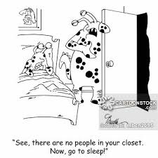
Normal anxiety
Realistic fear of a threatening object, place, or situation.
Anxiety Disorder
Irrational fear or avoidance of an object, place, or situation that poses little or no threat of danger.

Slide 12
Normal Anxiety
Anxiety Disorder
Occasional worry about circumstantial events, such as an exam or breakup, that may leave you upset.
Constant, chronic, and unsubstantiated worry that causes significant distress, disturbs your social life, and interferes with classes and work.

Slide 13
Normal Anxiety
Anxiety Disorder
Random cases of "nerves" or jitters; dizziness or sweating over an exam, presentation, or other important event.
Repeated, random panic attacks or persistent worry and anticipation of another panic attack and feelings of terror or impending doom.

Slide 14
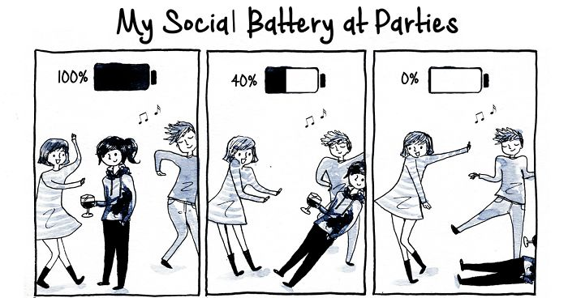
Normal Anxiety
Anxiety Disorder
Embarrassment or self-consciousness in the face of an uncomfortable social situation.
Avoidance of common social situations for fear of being judged, embarrassed, or humiliated.

Slide 15
Normal Anxiety
Anxiety Disorder
Wanting to feel confident that you are healthy and living in a safe, hazard free environment.
Performing uncontrollable, repetitive actions, such as washing your hands repeatedly or checking things over and over.

Slide 16
Anxiety
Anxiety Disorder
Anxiety, sadness, or difficulty sleeping immediately following a traumatic event.
Ongoing and recurring nightmares, flashbacks, or emotional numbing relating to a traumatic event in your life that occurred several months or years ago

Slide 19
Healthy coping with anxiety
Exercise.
Eat a balanced diet.
Limit alcohol and stay away from illegal drugs.
Get involved.
Do your best instead of trying to be perfect.
Take a time-out.
Put things in perspective.
Talk to someone.
Find out what triggers your anxiety.

Slide 20
Poor coping behaviors
Dissociation
Impulsive/compulsive behavior
Excessive behaviors
Overcompensation
Avoidance
Overdependence
Self-soothing
Notes:
withdrawn, fell numb, not connected, sleeping
instant gratification, Gambling, spending, sex
;; aggression, abuse, attention seeking
- Turning to substances, overeating, cutting…

Slide 21
Unhealthy coping with anxiety

Slide 23
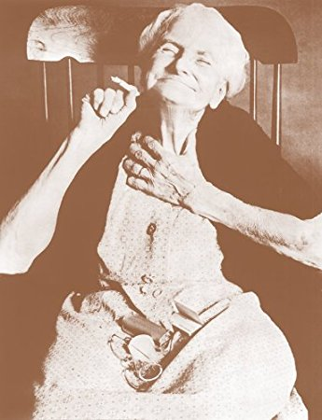
WHY DOES THIS TOPIC MATTER?
Controversial & provocative
More states with legalization laws
Increased teenage and adult use in states with legalized cannabis
2014/2015 survey data of past month use in Colorado adults showed:
51% higher than national average (2011/2012) → 124% percent higher
Notes:
The Legalization of Marijuana in Colorado: The Impact (Vol. 5, Rep.). (2017). Retrieved from http://www.rmhidta.org/html/FINAL%202017%20Legalization%20of%20Marijuana%20in%20Colorado%20The%20Impact.pdf

Slide 24
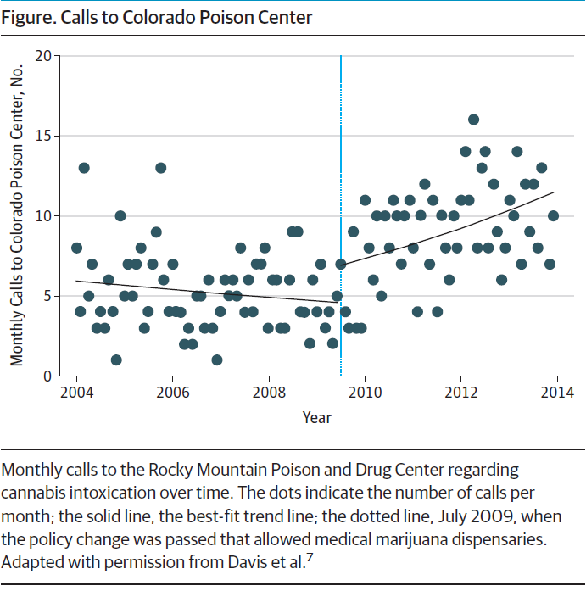
As of January 2016…
Compton, W. M., Volkow, N. D., & Lopez, M. F. (2017). Medical Marijuana Laws and Cannabis Use. JAMA Psychiatry. doi:10.1001/jamapsychiatry.2017.0723
Notes:
Pg 5 The Legalization of Marijuana in Colorado: The Impact Vol. 4/September 2016
As of January 2016, there were 424 retail marijuana stores in the state of Colorado compared to 322 Starbucks and 202 McDonald’s.
As you can see in this slide taken from Dr. Compton and Dr. Volkow’s recently published article “Medical Marijuana Laws and Cannabis Use,” from 2004-2009 there was a downward trend in monthly calls to the Colorado Rocky Mountain Poison and Drug Center regarding cannabis intoxication; however, from 2009 onwards, following a policy modification in Colorado that led to a significant increase in dispensaries and medical use, there was a parallel increase in calls to the poison center.

Slide 25
How does it work?
Two primary cannabinoids in Marijuana are
9-tetrahydrocannabidiol (THC)
Psychoactive
Partial agonist of CB1 and CB2 receptor
Cannabidiol (CBD)
Does not produce euphoria or intoxication
CB1 antagonist and CB2 inverse agonist
May modulate the effect of THC

Slide 26
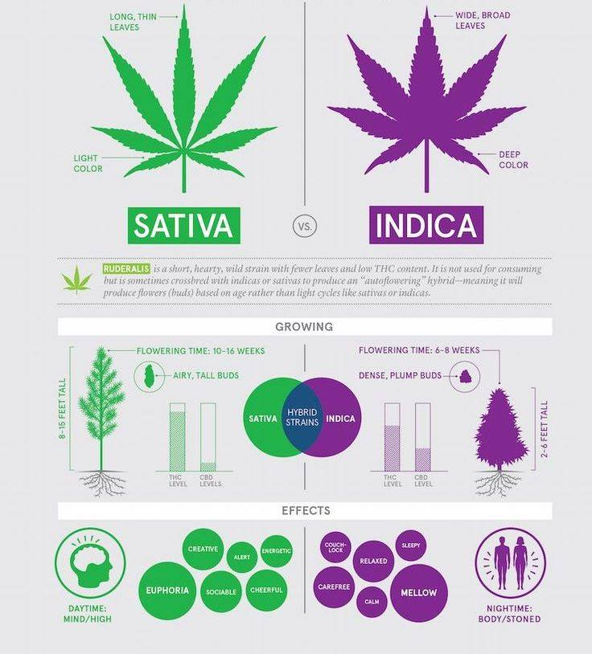
Higher THC:CBD ratio
More hallucinogenic
Stimulating, energizing (“cerebral high”)
Preferred for daytime use
Lower THC:CBD ratio
Calming, relaxing, sedating (“body high”)
Preferred for nighttime use
Notes:
There are hundreds of cultivated varieties of marijuana that are known by marijuana growers and users
It remains unclear exactly what biochemical differences exist between different varieties, so it is currently difficult to reliably describe medical differences
Marijuana strains are often identified initially by plant morphology:
There are cannabis Sativa plants and cannabis indica plants
Sativa plants have a lighter color and long, thin leaves
The plant also grows on average to 8-15 feet tall
It has a relatively higher THC:CBD ratio and therefore is more likely to induce hallucinogenic states. It’s described as more stimulating and energizing and is generally preferred for daytime use.
Indica plants have a deeper color with wide, broad leaves
On average they are shorter
They have a relatively lower THC:CBD ratio and are felt to induce more of a calming, relaxation or sedating effect.
This strain is more often used for analgesia or as a sleep aid
https://s-media-cache-ak0.pinimg.com/originals/2f/99/e0/2f99e08c6f276461867154f6f69d3657.jpg

Slide 29
Endocannabinoid system in humans
Anandamide and 2-arachonylglycerol (2-AG)
Plays a role in the regulation of appetite, memory, and other domains of cognition, mood, sleep, inflammation, and other physical and mental functions
Difference between marijuana and endocannabinoids in your brain:
ENDOGENOUS cannabinoids have short duration of action
EXOGENOUS cannabinoids have much longer, nonphysiological activation of cannabinoid receptors

Slide 32
Pharmaceutical formulations of Cannabinoids
Schedule III drugs

Slide 33
Louisiana Law
There will be 10 dispensaries spread across the state
Marijuana will be sold as oils, extracts, tinctures, sprays, capsules, pills, solutions, suspension, gelatin-based chewables, lotions, transdermal patches and suppositories.

Slide 34
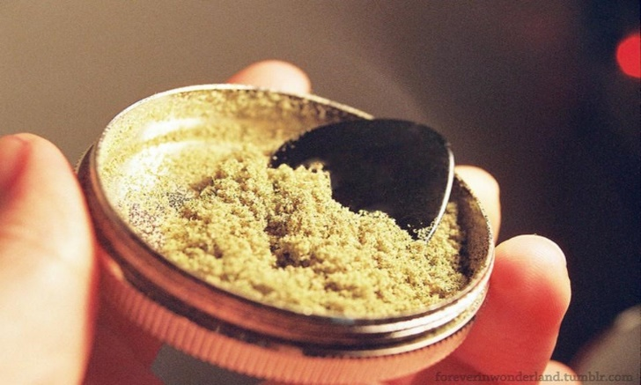
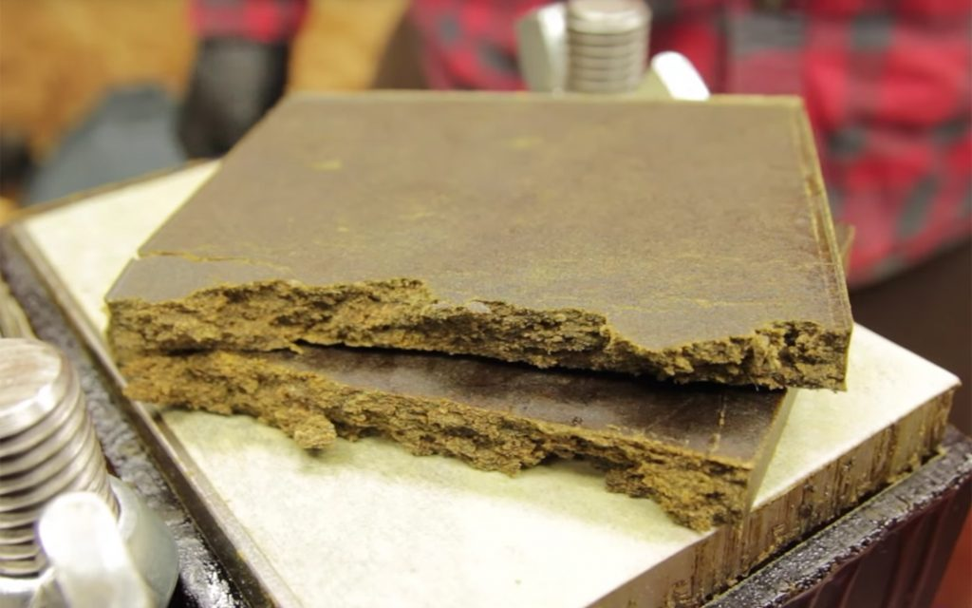
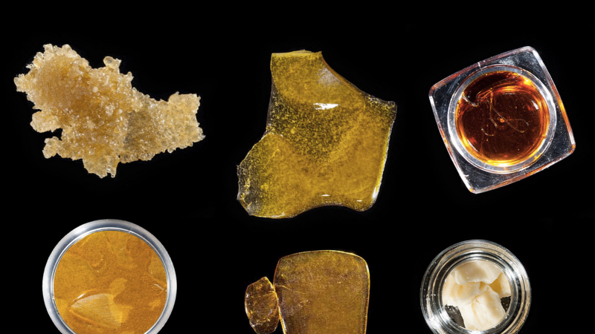
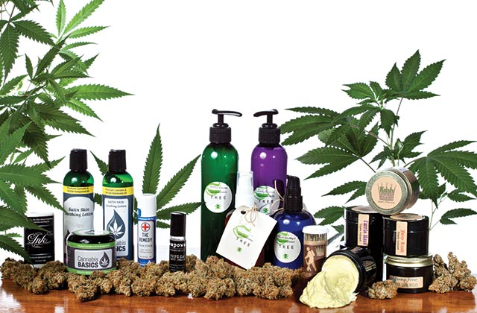
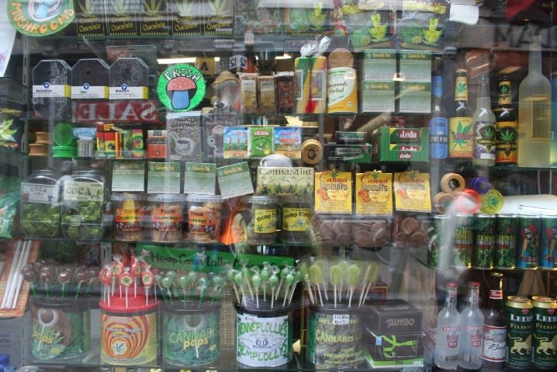
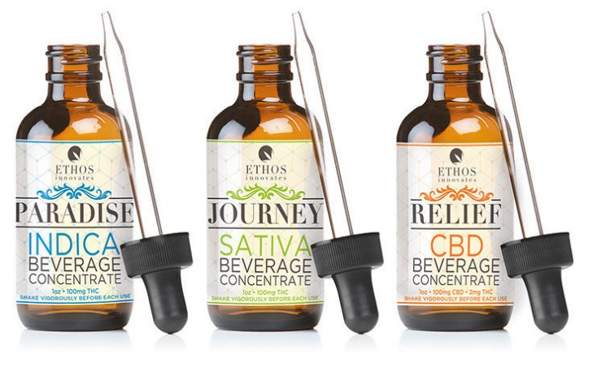
MEDICAL MARIJUANA FORMULATIONS
Notes:
Although many people think of smoking as the primary way to use marijuana, there are many other methods of ingesting or using marijuana products.
1) Kief: Powder extracted from cannabinoid-rich glands of the cannabis plant (trichomes). The powder can be smoked or compressed into cakes of hashish.
2) Hashish/hash: Concentrated trichomes with a higher THC content than plant material, often smoked (using a vaporizer, hookah, or in a joint) or mixed with food.
3) Hash oil: A mix of essential oils and resins extracted from marijuana plants using solvents such as ethanol or butane. The solvent is then evaporated, yielding an oil with a high concentration of THC. This can be smoked with a special pipe (sometimes referred to as “dabbing”), vaporized, or infused into food.
4) Edibles: Food products infused with cannabis. These may have cannabis added directly to them or may be made with butter, oil, or alcohol that has been infused with cannabis.
5) Tincture: Cannabinoids extracted using alcohol. Used in liquid form and absorbed through the mucous membranes of the mouth. They can also be administered sublingually in a spray form.
6) Topicals: Salve or a cream that can be applied topically. Usually made with an oil infused with cannabis.
Source: Americans for Safe Access
Thant, Marijuana and Mental Health 2016

Slide 35
Indications in Louisiana for Medical Marijuana
Act 261 (2015): cancer, HIV+, AIDS, cachexia or wasting syndrome, seizure disorders, spasticity, Crohn’s disease, muscular dystrophy and multiple sclerosis.
Act 708 (2018): glaucoma, Parkinson’s disease, severe muscle spasms, intractable pain and post traumatic stress disorder
Act 496 (2018): four conditions associated with autism spectrum disorder

Slide 36
QUALITY CONTROL
Pharmaceutical formulations
Standardized in formulation, composition and dose in order to meet regulatory requirements for prescription
Limited indications, very expensive.
Medical Marijuana formulations
Variability of potency between plants
Average THC content of 4% in 1995 → Average THC content > 12% in 2012
Susceptible to contamination from pesticides, molds, fungi and bacteria
No federal guidelines for testing of medical marijuana for either potency or contaminants
Notes:
Pharmaceutical forms of marijuana (e.g., dronabinol, nabilone) are standardized in formulation, composition, and dose in order to meet regulatory requirements for prescribing
The regulation of medical marijuana production, however is less stringent
In the popular press (e.g., Baca 2015), there are credible reports of profound discrepancies between the potency claimed on product labels and the potency demonstrated in laboratory analyses of commercially available marijuana products
This is partly due to the difficulty in standardizing plant material as the potency differs between individual plants and even between different parts of the a single plant.
Volkow et al reported that the potency of marijuana has increased substantially over the past 20 years, with an average THC content of less than 4% in 1995 compared with greater than 12% in 2012
As medical marijuana products are derived from plant material, they are also susceptible to contamination from pesticides, molds, fungi, and bacteria
Small studies have documented widespread Aspergillus contamination in particular (McLaren et al. 2008).
In the United States, there are no federal guidelines for the testing of medical marijuana for either potency or contaminants, and few state regulations exist
When I was first looking into this in 2015 Colorado had state licensed testing facilities and required testing of recreational marijuana products but for some reason these same regulations did not exist for medical marijuana products even though Colorado is considered to have one of the most regulated marijuana system in the US.
However Colorado now requires both medical and retail marijuana to be tested for things such as microbials, residual solvents, heavy metals and potency

Slide 39
Short Term
*Impaired short term memory/ability to learn/maintain
*Impaired motor coordination
*Altered judgment
*Paranoia
Long Term/Heavy
*Addiction: 9.1% of overall users, 17% of those who begin use in adolescence and 25-50% of daily users
Long Term/Heavy in Adolescents
*Altered brain development
*Psychosis
*Euphoria
*Immunosuppression
*Chronic bronchitis symptoms
*Increased risk of chronic psychotic disorder, including schizophrenia, in persons with predisposition to such disorders
*Sexual side effects
*Poor educational attainment/school dropout
*Cognitive impairment/lower IQ
*Diminished life satisfaction and achievement
*Cardiovascular effects including tachycardia and postural hypotension
*Decreased sperm counts
ADVERSE EFFECTS
Croxford 2003, Volkow et al. 2014

Slide 41
12 longitudinal studies (N= 11, 959)
PTSD, panic disorder, bipolar, MDD
Follow-up at 2.5 – 60 months
Cannabis users had more severe symptoms and lower rates of remission
Some studies showed link between stopping use and symptom improvement
Conclusion: Ongoing use that is more than occasional would likely hurt therapeutic outcomes but cessation/marked reduction of use to at most weekly would likely improve them
Notes:
12 longitudinal studies in 11,959 patients with PTSD, panic disorder, bipolar or MDD to determine the effect of cannabis use in less than or equal to 6 months before study entry on later outcomes (follow-up 2.5-60 months). Most patients were undergoing psychiatric treatment. For each diagnosis most studies showed that cannabis users had more severe symptoms and lower rates of remission than less frequent users or nonusers. Some studies showed links between stopping use and symptom improvement.
Ongoing use that is more than occassional would likely hurt therapeutic outcomes and cesation or marked reduction of use to at most weekly would likely improve them.

Slide 42
Summary on Marijuana and Anxiety
Medical evidence is not there yet to support its use for anxiety.
There are lots of dangers and potential adverse effects of marijuana.

Slide 43
LSU-OLOL Psychiatry Clinic
5131 Brittany Drive, 3rd floor. Phone # 374-0400
3rd and 4th year Psychiatry residents, with faculty supervision
Cash only, but Medicaid is coming…
$80 new patient, $40 med check, $25 therapy
We also have LSU psychology graduate students who offer testing and therapy.

Slide 44
Questions

